Slide 1



CYBERBULLYING TEXT CLASSIFICATION USING RNN TECHNIQUES
PRESENTED BY:
A.BALAKUMAR (927621BEC302)
A.S.KAVINESH (927621BEC081)
R.MIDHUN (927621BEC120)
S.MOHAMED ANAS (927621BEC121)
GUIDED BY:
Mr. P. T. SIVAGURUNATHAN
AP/ECE

Slide 2
INTRODUCTION
Cyberbullying Text Classification using RNN techniques is a project focused on developing algorithms that can automatically detect and classify instances of cyberbullying in text data
By leveraging Recurrent Neural Network (RNN) techniques, this project aims to enhance the accuracy and efficiency of identifying cyberbullying behavior in online communication
Ultimately, the goal is to create a reliable tool for detecting and addressing cyberbullying incidents to promote safer digital environments.

Slide 3
ABSTRACT
To develop a robust system for automatically detecting cyberbullying content in textual data. Leveraging Recurrent Neural Network (RNN) techniques, the model will analyze the sequential nature of language, providing a proactive approach to identifying and mitigating online harassment
The proposed solution holds promise for fostering a safer digital environment by effectively identifying and addressing instances of cyberbullying through advanced text classification methods

Slide 4
PROBLEM STATEMENT
The project aims to address the rising concern of cyberbullying by developing a text classification system utilizing Recurrent Neural Network (RNN) techniques
The goal is to create a robust model capable of accurately identifying and categorizing instances of cyberbullying in online text data
This initiative seeks to contribute to the development of effective tools for combating digital harassment and promoting a safer online environment

Slide 5
OBJECTIVE
The objective of the "Cyberbullying Text Classification Using RNN Techniques" project is to develop a robust system capable of identifying and categorizing instances of cyberbullying in textual content
This includes implementing recurrent neural network (RNN) techniques to analyze the sequential nature of language and detect subtle patterns indicative of cyberbullying behavior
The aim is to contribute to the creation of effective tools for online safety, fostering a safer digital environment through proactive identification and mitigation of cyberbullying instances

Slide 6





SOFTWARE REQUIREMENT

Slide 7
EXISTING SYSTEM
Existing methods for cyberbullying text classification often involve traditional machine learning techniques such as Support Vector Machines (SVM) or Naive Bayes
Some approaches leverage feature engineering, extracting linguistic features and sentiment analysis to identify harmful content. However, recent advancements in natural language processing have shown promise in utilizing Recurrent Neural Networks (RNN) for more effective cyberbullying detection, capturing contextual nuances and patterns in text data

Slide 8
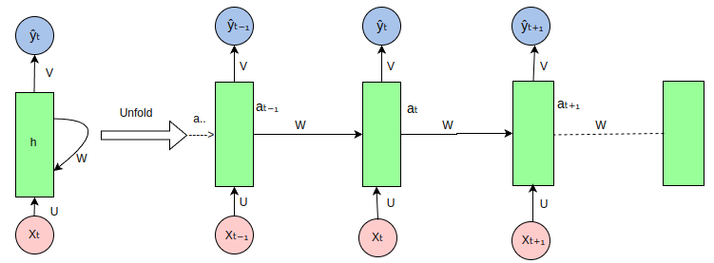
RNN ARCHITECTURE
aₜ = f(U * Xₜ + W* aₜ₋₁ + b)

Slide 9
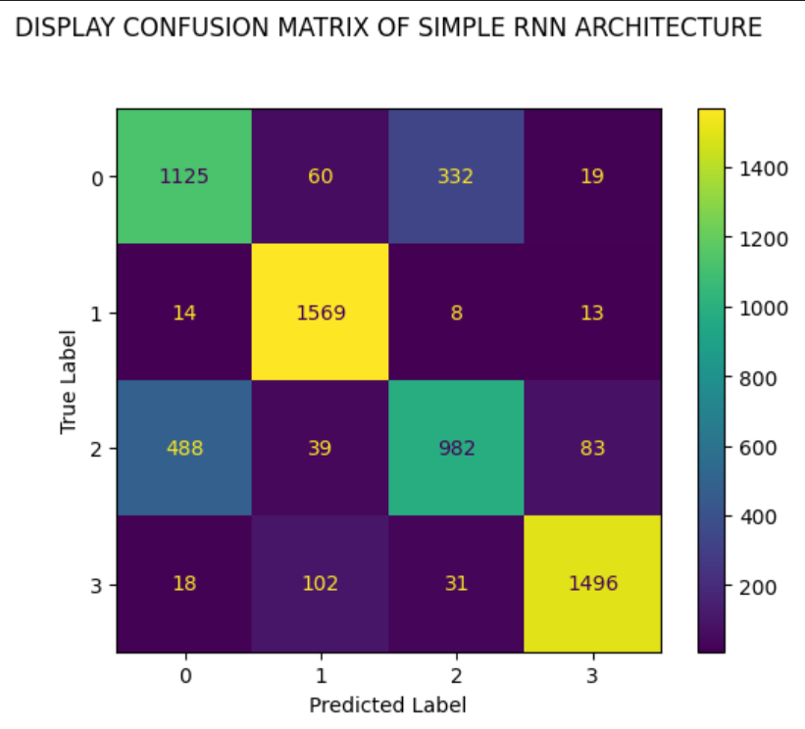
CONFUSION MATRIX OF RNN
LEGEND:
0-RELIGION
1-AGE
2-ETHINICITY
3-NOT_CYBERBULLING

Slide 10
RESULT IN RNN TECHNIQUES
CLASSFICATION | PRECISON | RECALL | F_SCORE | SUPPORT
RELIGION | 0.73 | 0.68 | 0.71 | 1645
AGE | 0.98 | 0.89 | 0.93 | 1770
ETHINICITY | 0.62 | 0.73 | 0.67 | 1353
NOT_CYBERBULLING | 0.91 | 0.93 | 0.92 | 1611

Slide 11
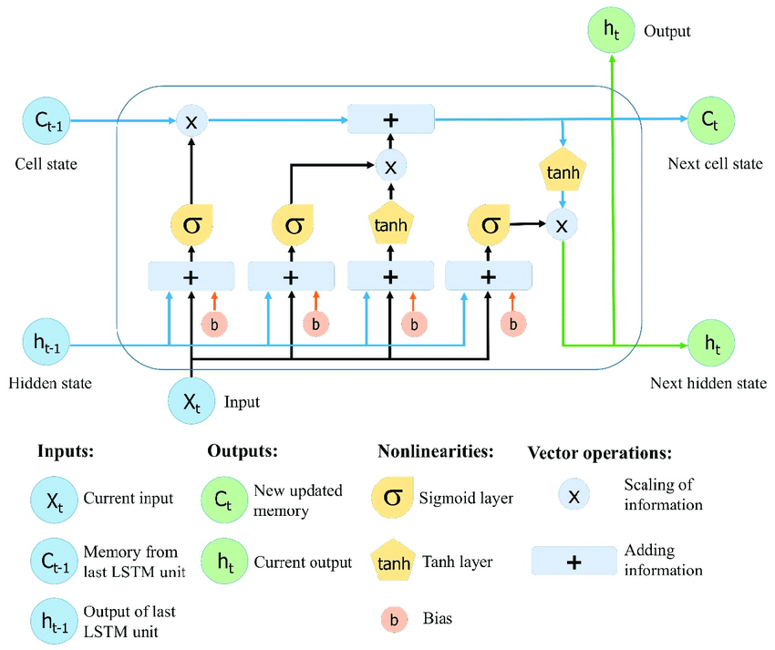
LSTM ARCHITECTURE

Slide 12
LSTM ARCHITECTURE

Slide 13
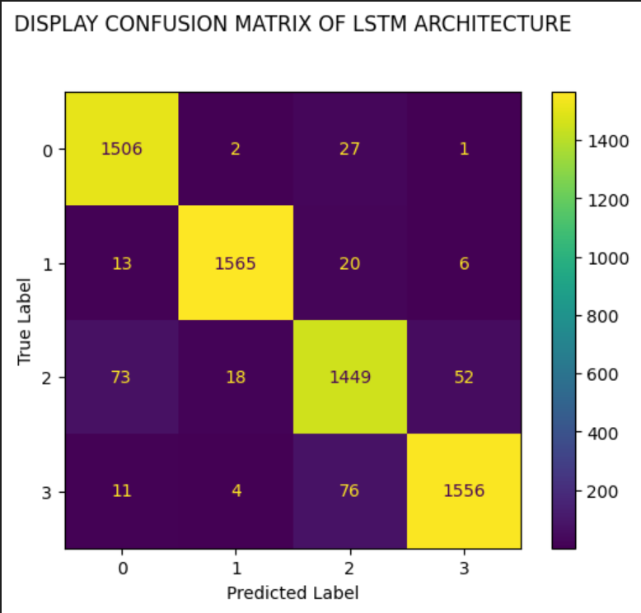
CONFUSION MATRIX OF LSTM
LEGEND:
0-RELIGION
1-AGE
2-ETHINICITY
3-NOT_CYBERBULLING

Slide 14
RESULT IN LSTM TECHNIQUES
CLASSFICATION | PRECISON | RECALL | F_SCORE | SUPPORT
RELIGION | 0.94 | 0.98 | 0.96 | 1536
AGE | 0.98 | 0.98 | 0.98 | 1604
ETHINICITY | 0.92 | 0.91 | 0.92 | 1592
NOT_CYBERBULLING | 0.96 | 0.94 | 0.95 | 1647

Slide 15
RNN VS LSTM
MODEL | ACCURACY | LOSS
RNN | 81.07 | 18.92
LSTM | 95.25 | 4.74

Slide 16
REFERENCES
[1] S. Thomas, R. A. Sadafale, et al,. "Detecting Cyberbullying on Social Media Using Deep Learning Techniques" Published in 2019 International Conference on Machine Learning, Big Data, Cloud and Parallel Computing (COMITCon)
[2] S. Rajput, R. Gupta, et al,. "Cyberbullying Detection on Social Media Using Deep Learning” Published in a Survey 2020 5th International Conference on Computing, Communication and Security (ICCCS)
[3] P. Choudhary, S. Sharma, et al ,."Cyberbullying Detection on Social Media Using Deep Learning” Published in 2021 4th International Conference on Intelligent Sustainable Systems (ICISS)

Slide 17


